Slide 1
How Computing Works -
Modern Paradigms of Architecture & System
2. Compilation & Interpretation
计算如何运作 – 架构与系统的现代范式
2. 编译与解释
Cong Li 李聪

Slide 2
Let’s Start … 让我们开始……
We write programs to solve computing problems
我们用编程来解决计算问题
So we start from a problem
所以我们从一个问题开始

Slide 3

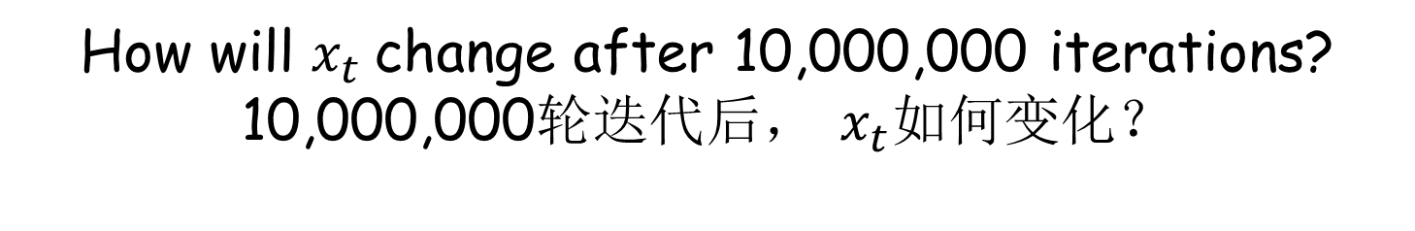

Iterative Calculation 迭代计算
Initially 初始时
$$x_{0}=0$$
Iterate 迭代
$$x_{t}=1−μx_{t−1}^{2}$$
How will $x_{t}$change after 10,000,000 iterations?
10,000,000轮迭代后， $x_{t}$如何变化？

Slide 4

Practice 2.1 实践2.1
Practice time: iterative calculation
实践时刻：迭代计算
Use Python to write a simple program
用Python编写一个简单的程序

Slide 5
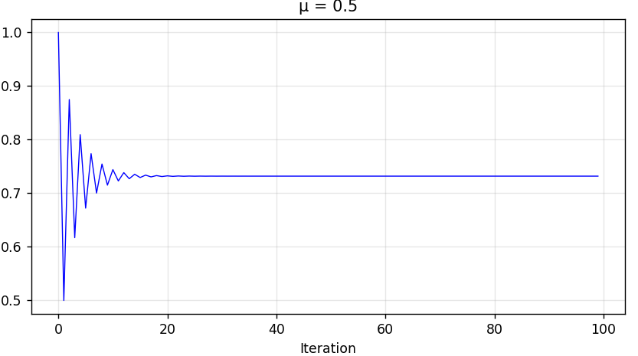
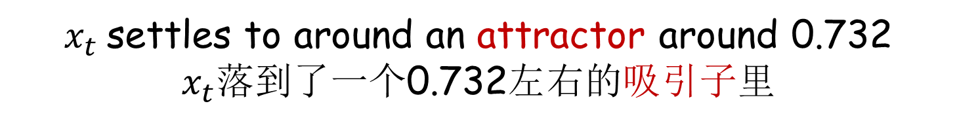
What We Saw 我们看到了
$x_{t}$settles to around an attractor around 0.732
$x_{t}$落到了一个0.732左右的吸引子里

Slide 6

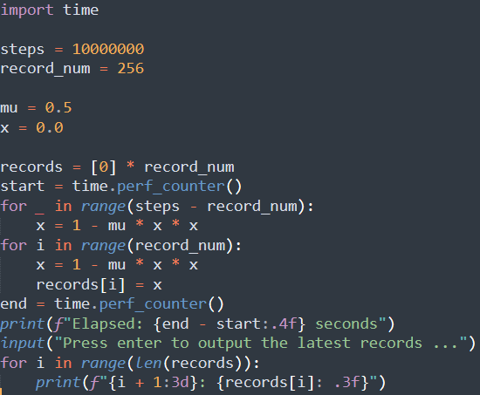
We Got the Execution Results
我们获得了运行结果
Execution
运行
Then how was the Python program executed?
然而这个Python程序是怎么被运行的？

Slide 7
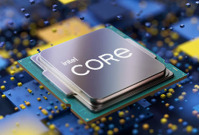
Execution Not Simple
运行并非简单
CPU
Direct execution
直接运行
Python statement
Python语句
X
CPU cannot directly execute Python statements
CPU不能直接运行Python语句

Slide 8
Low-Level CPU Instructions
底层CPU指令
CPU
Direct execution
直接运行
mulsd %xmm0,%xmm1
…
subsd %xmm1, %xmm0
CPU can only execute predefined instructions
CPU只能执行特定的指令

Slide 9
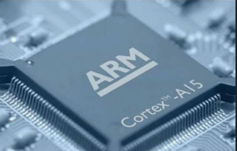
On a Different CPU …
换了一个CPU
mulsd %xmm0,%xmm1
…
subsd %xmm1, %xmm0
fmul d1, d1, d0
…
fsub d0, d2, d1
Different CPUs may need different instructions
不同的CPU可能需要不同的指令

Slide 10
Rough View of Interpreter
解释器的粗略图景
Interpreter
解释器
Runtime conversion of Python programs to CPU instruction execution
在执行时将Python程序转换成CPU指令的执行

Slide 11
Rough View of Interpreter
解释器的粗略图景
Interpreter
解释器
Itself in CPU instructions & executed directly on CPU
本身是CPU指令构成的程序，能直接在CPU上执行

Slide 12
Rough View of Interpreter
解释器的粗略图景
Interpreter
解释器
Walk through statements
逐条追踪语句
Python program
Python程序

Slide 13
Rough View of Interpreter
解释器的粗略图景
Interpreter
解释器
Parse statements & translate to instructions for execution
解析语句并转译为指令执行

Slide 14
Interpreted Execution
解释执行 (1)
Happen During Runtime 运行时才进行
  Natural trace of the execution
  自然而然的执行踪迹
    Debugging friendly 便于调试
  Natural support for dynamicity, e.g.,
  自然而然支持动态性，例如
    Changing data type of a variable 一个变量的数据类型可变

Slide 15
Interpreted Execution
解释执行 (2)
Disadvantage: Slow 缺点：慢
  Overhead in walking through statements & translating to instructions
  逐行追踪语句和翻译指令的开销
  Repeated work, e.g., 重复工作，例如
    Translation of the same statement executed repeatedly 同一语句多次执行时的翻译
    Interpretation of repeated execution of the same program 同一程序多次执行时的解释

Slide 16
Natural Questions
自然而然的问题
Can we minimize the walk-through
overhead & the repetitive work?
我们能不能尽量减少逐行追踪语句的开销和重复工作
If anyway we need to execute in CPU instructions, can we perform the conversion once & for all?
倘若无论如何我们需要执行CPU指令，我们能不能一劳永逸地进行一次性的指令转换？
This is compilation 这就是编译？

Slide 17
Practice 2.2 实践2.2
Practice time: iterative calculation compiled
实践时刻：编译的迭代计算
Use C/C++ to write the simple program
用C/C++编写这个简单的程序

Slide 18
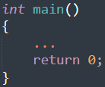
What’s Your Feeling?
感觉如何？(1)
More Code 代码更多
  More formal, e.g. 更正规，例如
    Variables w/ data types specified
    变量需要确定数据类型
    Function & return 函数与返回

Slide 19
What’s Your Feeling?
感觉如何？(2)
Compilation First 先编译
  Before we can execute 需在执行之前
Much Faster Execution 执行快很多
  Order-of-magnitude difference
  有数量级的差异

Slide 20
Recall … 回忆……
We write programs to solve computing problems
我们用编程来解决计算问题
This problem sounds like a trivial toy
这个问题看起来象一个寡淡无味的摆设
But is it really a trivial toy?
但它真是一个寡淡无味的摆设吗？

Slide 21

Practice 2.3 实践2.3
Practice time: change $μ$ & see what happens
实践时刻：改变$μ$看看发生了什么
Try both Python & C/C++ programs
分别用Python和C/C++程序尝试

Slide 22
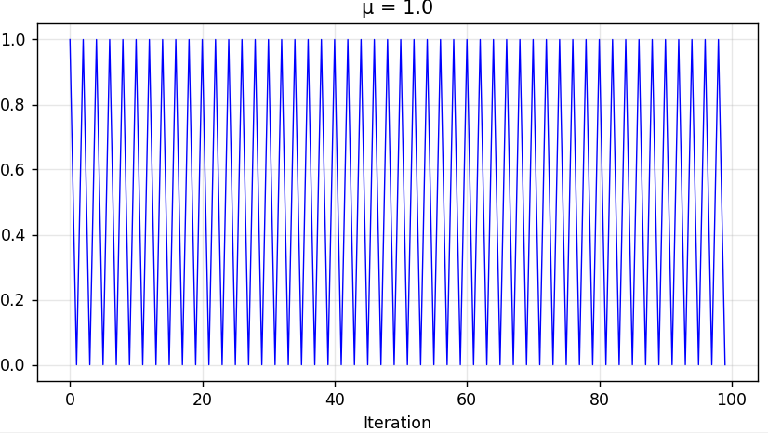

Changing $μ$ 改变$μ$ (1)
Period-2 cycle
2-周期吸引子

Slide 23
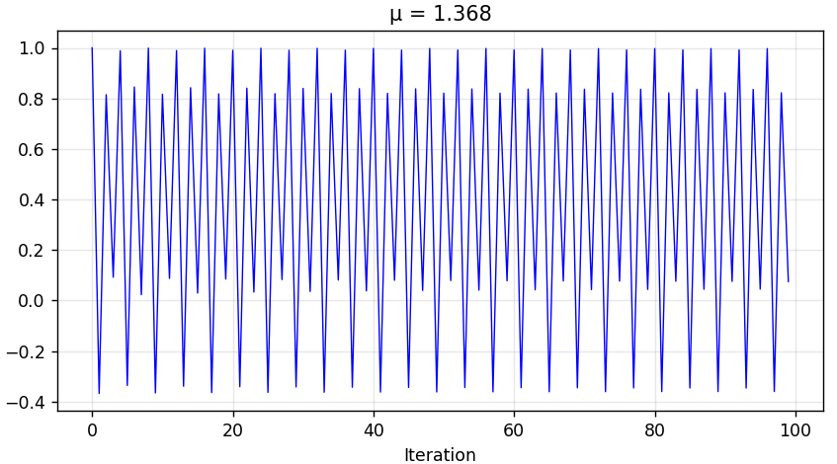

Changing $μ$ 改变$μ$ (2)
Period-4 cycle
4-周期吸引子

Slide 24
Now What’s Your Feeling?
现在感觉如何？
While the compiled execution is faster …
尽管编译执行更快
Each change needs the compilation before running
每次程序改动我们都需要重新编译才能运行
Interpreted execution can start promptly
解释执行随时可以进行
But wait, can’t we calculate multiple series in 1 program? 等一下，我们难道不能在一个程序里计算多个数列吗？

Slide 25
Practice 2.4 实践2.4
Practice time: calculate 16 series in 1 program
实践时刻：一个程序计算16个序列
Try Python first
先用Python

Slide 26
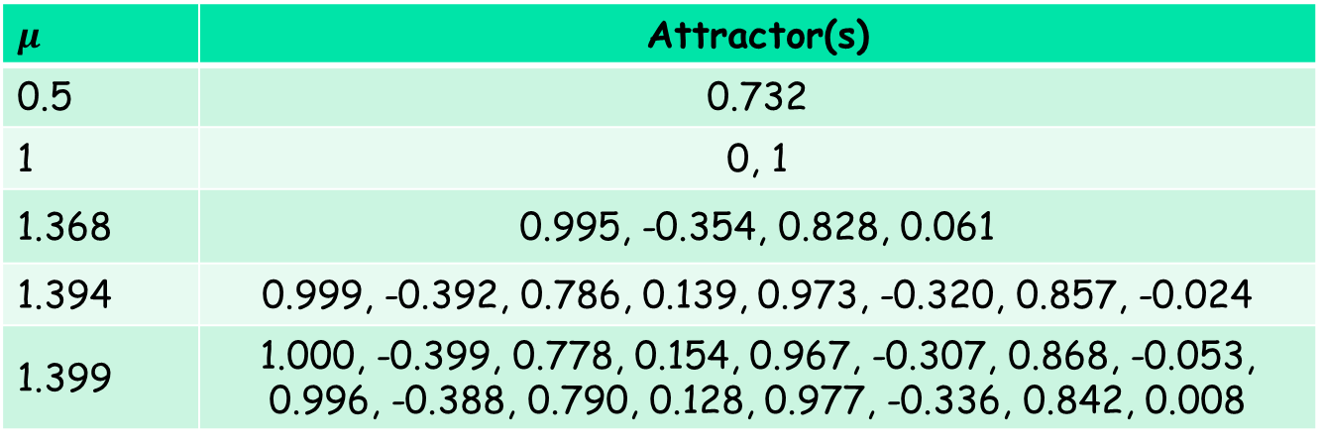
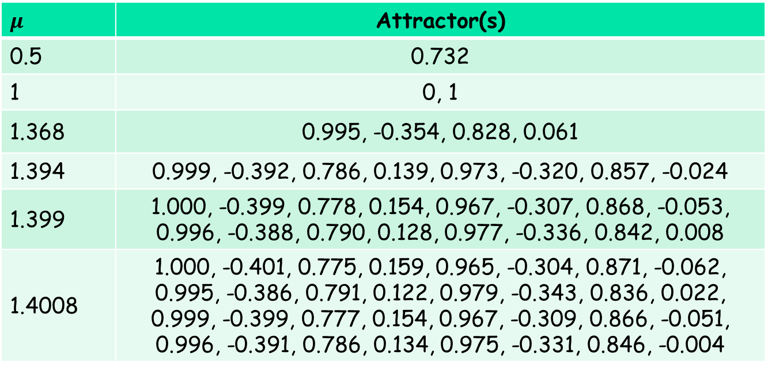
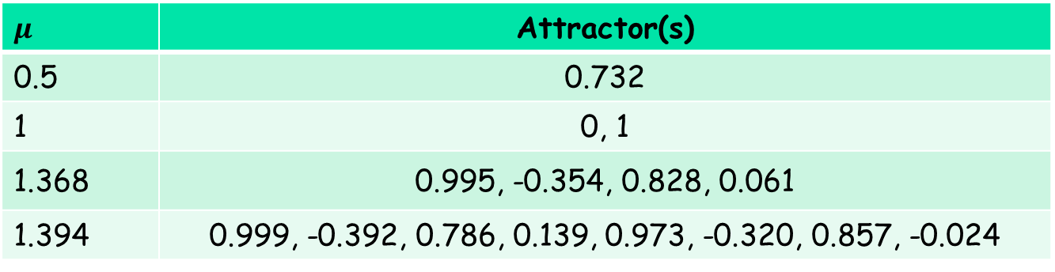
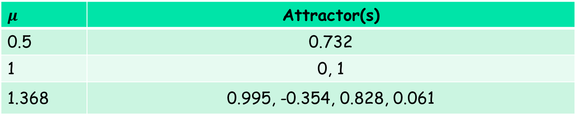
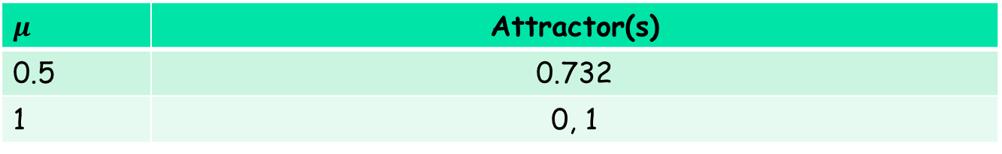
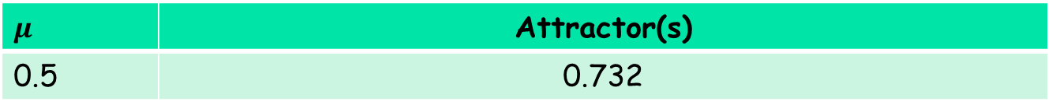
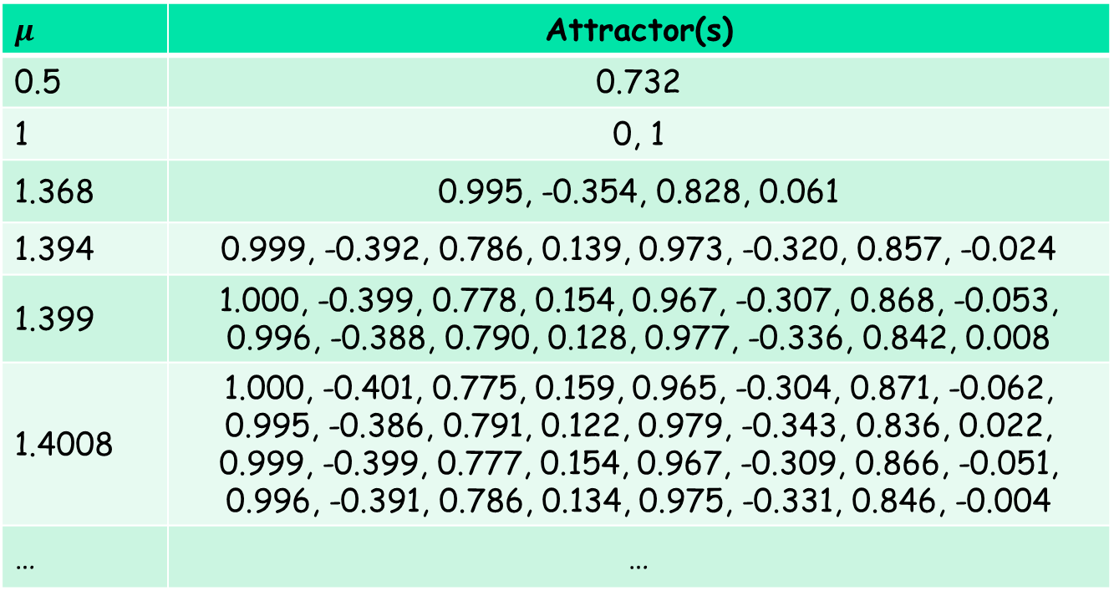
More & More Chaotic
愈发混乱
$$μ$$ | Attractor(s)
0.5 | 0.732
1 | 0, 1
1.368 | 0.995, -0.354, 0.828, 0.061
1.394 | 0.999, -0.392, 0.786, 0.139, 0.973, -0.320, 0.857, -0.024
1.399 | 1.000, -0.399, 0.778, 0.154, 0.967, -0.307, 0.868, -0.053, 0.996, -0.388, 0.790, 0.128, 0.977, -0.336, 0.842, 0.008
1.4008 | 1.000, -0.401, 0.775, 0.159, 0.965, -0.304, 0.871, -0.062, 0.995, -0.386, 0.791, 0.122, 0.979, -0.343, 0.836, 0.022, 0.999, -0.399, 0.777, 0.154, 0.967, -0.309, 0.866, -0.051, 0.996, -0.391, 0.786, 0.134, 0.975, -0.331, 0.846, -0.004
$$μ$$ | Attractor(s)
0.5 | 0.732
1 | 0, 1
1.368 | 0.995, -0.354, 0.828, 0.061
1.394 | 0.999, -0.392, 0.786, 0.139, 0.973, -0.320, 0.857, -0.024
1.399 | 1.000, -0.399, 0.778, 0.154, 0.967, -0.307, 0.868, -0.053, 0.996, -0.388, 0.790, 0.128, 0.977, -0.336, 0.842, 0.008
1.4008 | 1.000, -0.401, 0.775, 0.159, 0.965, -0.304, 0.871, -0.062, 0.995, -0.386, 0.791, 0.122, 0.979, -0.343, 0.836, 0.022, 0.999, -0.399, 0.777, 0.154, 0.967, -0.309, 0.866, -0.051, 0.996, -0.391, 0.786, 0.134, 0.975, -0.331, 0.846, -0.004
… | …
$$μ$$ | Attractor(s)
0.5 | 0.732
$$μ$$ | Attractor(s)
0.5 | 0.732
1 | 0, 1
$$μ$$ | Attractor(s)
0.5 | 0.732
1 | 0, 1
1.368 | 0.995, -0.354, 0.828, 0.061
$$μ$$ | Attractor(s)
0.5 | 0.732
1 | 0, 1
1.368 | 0.995, -0.354, 0.828, 0.061
1.394 | 0.999, -0.392, 0.786, 0.139, 0.973, -0.320, 0.857, -0.024
$$μ$$ | Attractor(s)
0.5 | 0.732
1 | 0, 1
1.368 | 0.995, -0.354, 0.828, 0.061
1.394 | 0.999, -0.392, 0.786, 0.139, 0.973, -0.320, 0.857, -0.024
1.399 | 1.000, -0.399, 0.778, 0.154, 0.967, -0.307, 0.868, -0.053, 0.996, -0.388, 0.790, 0.128, 0.977, -0.336, 0.842, 0.008

Slide 27
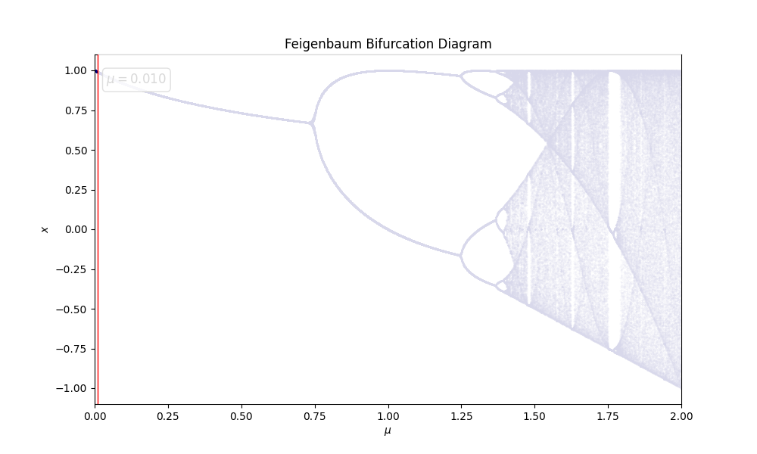
Feigenbaum Bifurcation
费根鲍姆分岔

Slide 28
Practice 2.5 实践2.5
Practice time: calculate 16 series in 1 program
实践时刻：一个程序计算16个序列
Try C/C++ then
再用C/C++

Slide 29
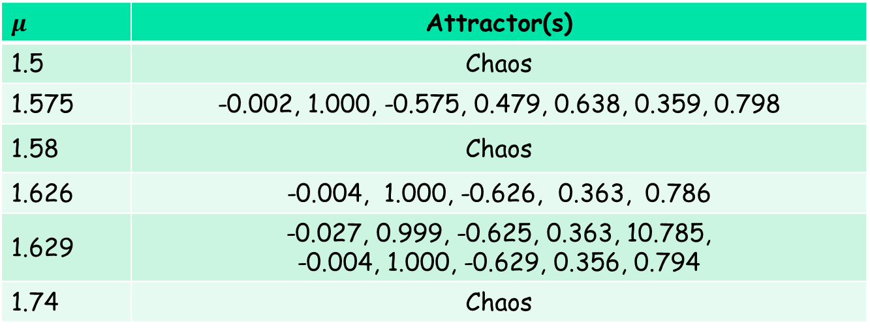
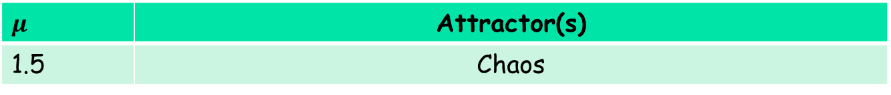
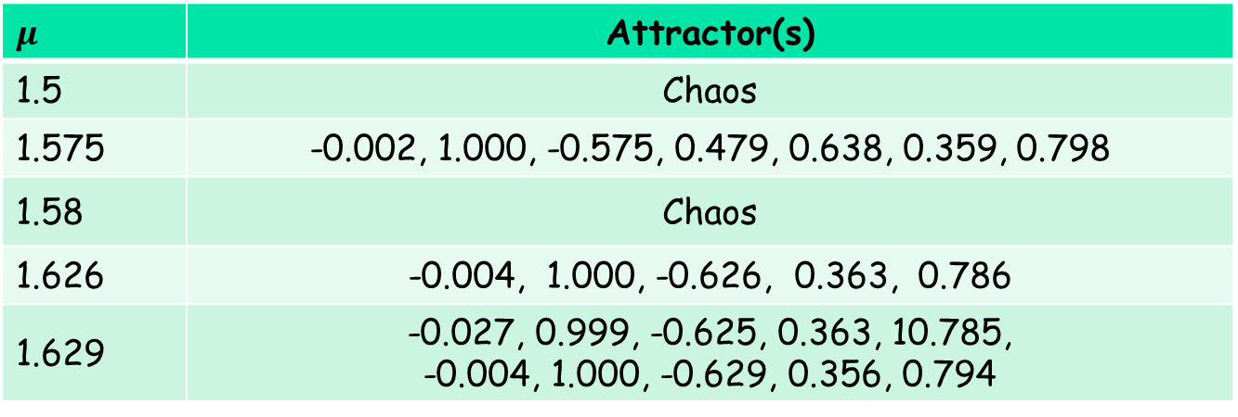
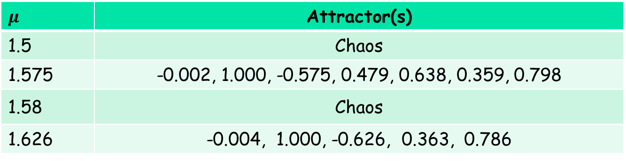
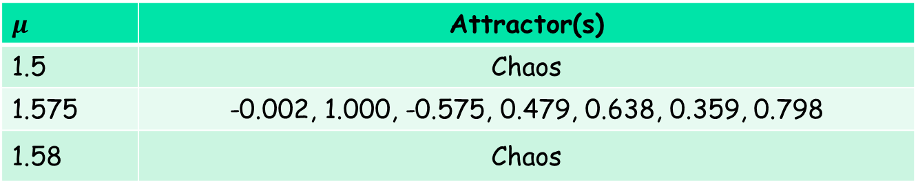
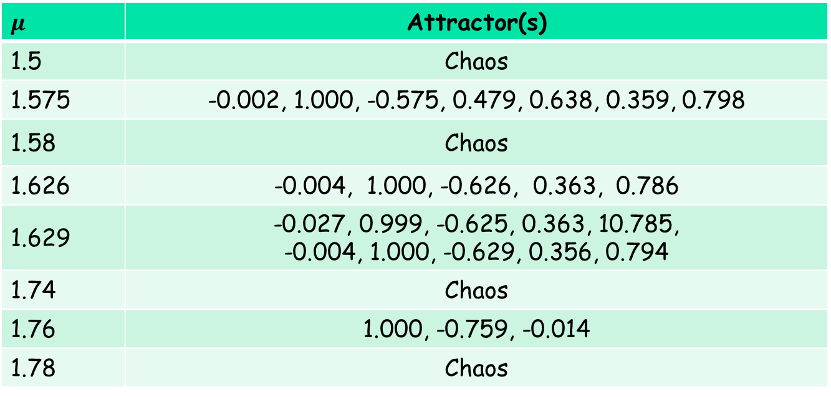
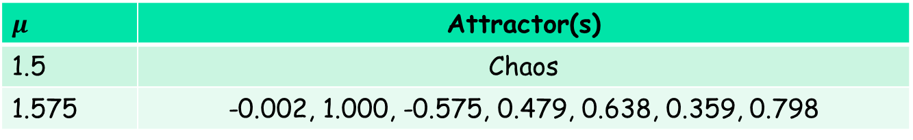
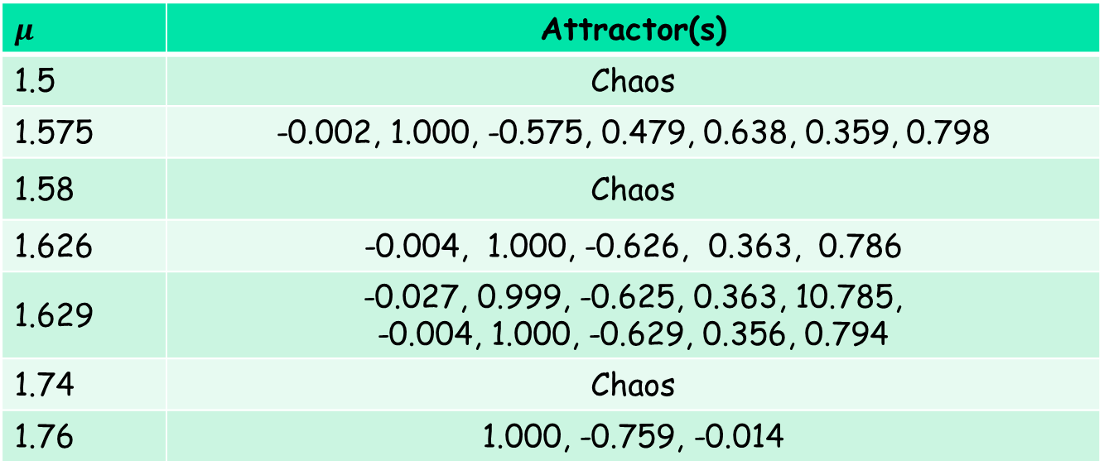
Chaos & Order
混沌与有序
$$μ$$ | Attractor(s)
1.5 | Chaos
1.575 | -0.002, 1.000, -0.575, 0.479, 0.638, 0.359, 0.798
1.58 | Chaos
1.626 | -0.004, 1.000, -0.626, 0.363, 0.786
1.629 | -0.027, 0.999, -0.625, 0.363, 10.785, -0.004, 1.000, -0.629, 0.356, 0.794
1.74 | Chaos
1.76 | 1.000, -0.759, -0.014
1.78 | Chaos
$$μ$$ | Attractor(s)
1.5 | Chaos
$$μ$$ | Attractor(s)
1.5 | Chaos
1.575 | -0.002, 1.000, -0.575, 0.479, 0.638, 0.359, 0.798
$$μ$$ | Attractor(s)
1.5 | Chaos
1.575 | -0.002, 1.000, -0.575, 0.479, 0.638, 0.359, 0.798
1.58 | Chaos
$$μ$$ | Attractor(s)
1.5 | Chaos
1.575 | -0.002, 1.000, -0.575, 0.479, 0.638, 0.359, 0.798
1.58 | Chaos
1.626 | -0.004, 1.000, -0.626, 0.363, 0.786
$$μ$$ | Attractor(s)
1.5 | Chaos
1.575 | -0.002, 1.000, -0.575, 0.479, 0.638, 0.359, 0.798
1.58 | Chaos
1.626 | -0.004, 1.000, -0.626, 0.363, 0.786
1.629 | -0.027, 0.999, -0.625, 0.363, 10.785, -0.004, 1.000, -0.629, 0.356, 0.794
$$μ$$ | Attractor(s)
1.5 | Chaos
1.575 | -0.002, 1.000, -0.575, 0.479, 0.638, 0.359, 0.798
1.58 | Chaos
1.626 | -0.004, 1.000, -0.626, 0.363, 0.786
1.629 | -0.027, 0.999, -0.625, 0.363, 10.785, -0.004, 1.000, -0.629, 0.356, 0.794
1.74 | Chaos
$$μ$$ | Attractor(s)
1.5 | Chaos
1.575 | -0.002, 1.000, -0.575, 0.479, 0.638, 0.359, 0.798
1.58 | Chaos
1.626 | -0.004, 1.000, -0.626, 0.363, 0.786
1.629 | -0.027, 0.999, -0.625, 0.363, 10.785, -0.004, 1.000, -0.629, 0.356, 0.794
1.74 | Chaos
1.76 | 1.000, -0.759, -0.014

Slide 30
Reinforcing the Feeling
强化我们的感觉
 | Interpretation 解释 | Compilation 编译
Execution speed 运行速度 | Slow 慢 | Fast 快
Bring up 开启运行 | Instant 即刻 | A compilation step first 预先编译
Programming 编程 | Naturally easy & dynamic 自然而然的便利和动态性 | More rigid/static 更为严格、静态
 | Interpretation 解释 | Compilation 编译
Execution speed 运行速度 | Slow 慢 | Fast 快
 | Interpretation 解释 | Compilation 编译
Execution speed 运行速度 | Slow 慢 | Fast 快
Bring up 开启运行 | Instant 即刻 | A compilation step first 预先编译

Slide 31
But One More Thing
但还有一点
mulsd %xmm0,%xmm1
fmul d1, d1, d0
Remember: Different CPUs run different instructions 记住：不同的CPU运行不同的指令

Slide 32
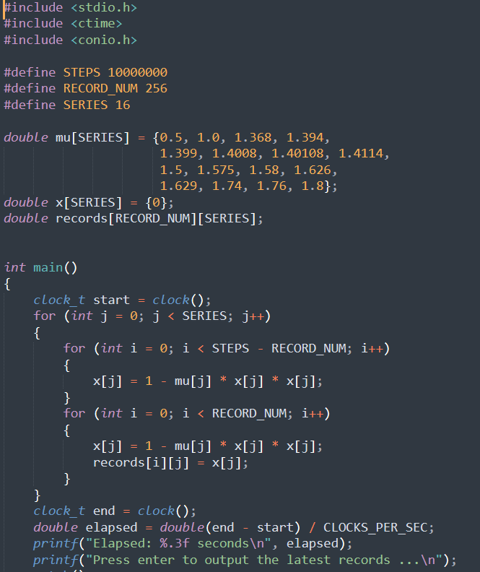

But One More Thing
但还有一点
Compile
编译
Run
运行
Not runnable
无法运行
X
Executables compiled for your PC cannot run on your phone 为PC编译的可执行程序不能在手机上运行

Slide 33

But One More Thing
但还有一点
Compile
编译
Run
运行
Run
运行
Compile differently
不同的编译
You need different compiled executables
你需要不同的编译后的可执行程序

Slide 34
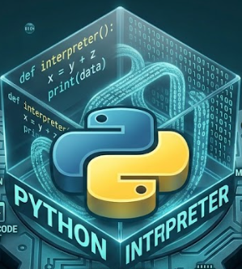
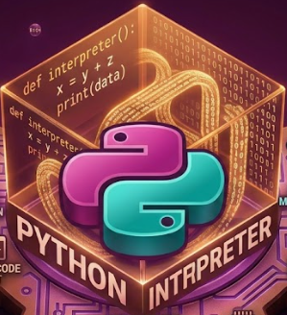
But One More Thing
但还有一点
Different Python interpreters pre-installed
不同的Python解释器已预装

Slide 35
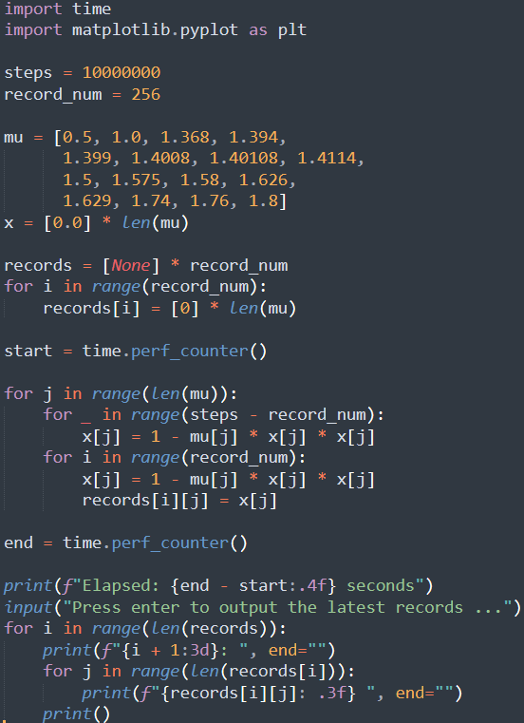
But One More Thing
但还有一点
Interpreted
解释
Executed
执行
Cost of portability usually hidden
移植的代价通常被隐藏了

Slide 36
Natural Question
自然而然的问题
Interpretation or compilation,
can we strike a balance?
解释与编译，我们能不能在两者间找到一个平衡？
Python, as a modern high-level programming language, is actual a hybrid
作为现代编程语言，Python其实是两者的混合

Slide 37
Recall the Repeated Work
回忆重复的工作
Translation of the Same Statement Executed Repeatedly
同一语句多次执行时的翻译
  Python statement (string) → executing CPU instructions
  Python语句（字符串） → 执行CPU指令
  What need to be done in the process?
  过程中我们要做什么

Slide 38
What to Be Done
要做什么
String Parsing 字符串分析
  Following Python grammar to extract the semantics, e.g.,
  遵从Python语法以抽取语义，例如
same as 等同于
Spaces around operators do not matter
操作符周围的空格无所谓

Slide 39
What to Be Done
要做什么
String Parsing 字符串分析
  Following Python grammar to extract the semantics, e.g.,
  遵从Python语法以抽取语义，例如
It’s a name of a variable
这是一个变量的名字

Slide 40
What to Be Done
要做什么
String Parsing 字符串分析
  Following Python grammar to extract the semantics
  遵从Python语法以抽取语义
  This can be done only once for a statement 一句语句只需要做一次
Executing CPU Instructions
执行CPU指令
  Based on the semantics 基于对应语义

Slide 41
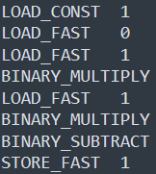
Partial Compilation 部分编译
Compile the statement (string) into an intermediate representation (IR)
将语句（字符串）编译成一个中间表示
Many other high-level programming languages employ such a step, e.g., Java, C#, etc.
很多其他高级编程语言使用了这一步，例如Java、C#

Slide 42

Partial Compilation 部分编译
Compile the statement (string) into an intermediate representation (IR)
将语句（字符串）编译成一个中间表示
Follow the IR to execute CPU instructions
根据中间表示执行CPU指令
Next for this part 然后我们看这部分

Slide 43

Example: PyTorch
例子：PyTorch
We’re in the AI era 我们身处AI时代
PyTorch is the most popular
AI framework extending Python
PyTorch拓展了Python，是最流行的AI编程框架

Slide 44
Example: PyTorch
例子：PyTorch
We’re in the AI era 我们身处AI时代
PyTorch is the most popular
AI framework extending Python
PyTorch拓展了Python，是最流行的AI编程框架
A lot of AI operators predefined
预定义了许多AI算子

Slide 45

Pre-Compiled Implementation
预编译的实现
PyTorch SDPA operator PyTorch的SDPA算子
Very complex calculation 非常复杂的计算
Dispatched by the interpreter to the implementation pre-compiled for the platform
被解释器调派给了为该平台预编译的实现

Slide 46
Then the Question
随之而来的问题
What if I have a customized expensive calculation w/o a precompiled implementation
假如我有一个自己定制的高代价计算，
并不存在已有的预编译实现呢？
Such as our iterative calculation example
就像我们的迭代计算例子
Just-in-time compilation comes to play
即时编译出场了

Slide 47
Just-in-Time Compilation
即时编译
Just-in-Time (JIT) 即时
  Right before ‘you need’
  恰好在“你需要”之时
  During interpretation, e.g.,
  在解释过程中，例如
    Warm-up process “预热”过程
Also a Common Feature
也是一个常见的特性
  In, e.g., Java, C#, torch.compile
  例如在Java、C#、torch.compile中

Slide 48
Practice 2.6 实践2.6
Practice time: calculate 16 series in Python
实践时刻：Python程序计算16个序列
Try JIT compilation
尝试即时编译

Slide 49
Highly Dynamic: Examples
高动态性：例子
Hotspot Identification 发现热点
  Decide what to compile 决定什么需要编译
On-Stack Replacement 动态切换
  Replace w/ the compile code online
  在线加载编译后的实现
Guard the Dynamics 守护动态性
  De-optimize w/ an incompatible data type 数据类型不匹配时放弃使用编译后的实现

Slide 50
It’s a Simple Introduction
这是个简单的介绍
For us to get some ideas on how program runs
使我们对程序如何运行有一些基本的了解
In the future we’ll see how compilation further optimizes the execution beyond ‘eliminating repeated work of interpretation’
未来的课程中我们还会看到，在消除解释执行的重复工作之外，编译如何进一步优化程序运行

Slide 51
The End

